Slide 1
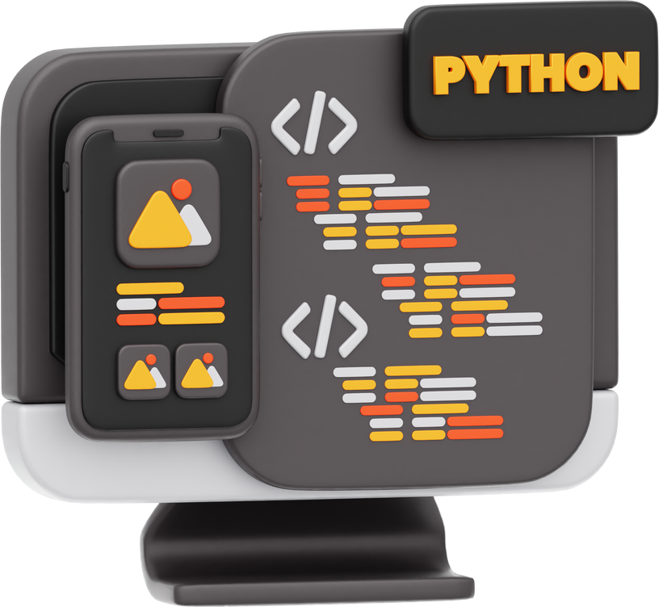
Huron Business Analytics Club
Python Portfolio Workshop
Case + Python Technique + Portfolio

Slide 2
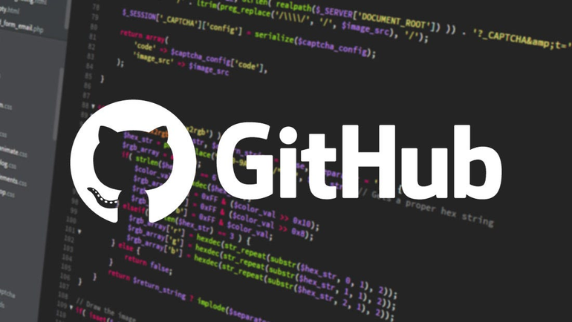


Personal Portfolio
Best For Code Display
Easy Front End Display
Graphic Design Display

Slide 3

GitHub
GitHub
Walk Through
Click here for github

Slide 4

Git
Git Download (Optional)

Slide 5

Monica Powel’s Github: A Model Profile
-Engaging Visuals
Colourfull Attantion-grabbing Visuals
External links
Memorable First Impression
-Easy to Comprehend
Consise Biography
Increases Positive connection

Slide 6
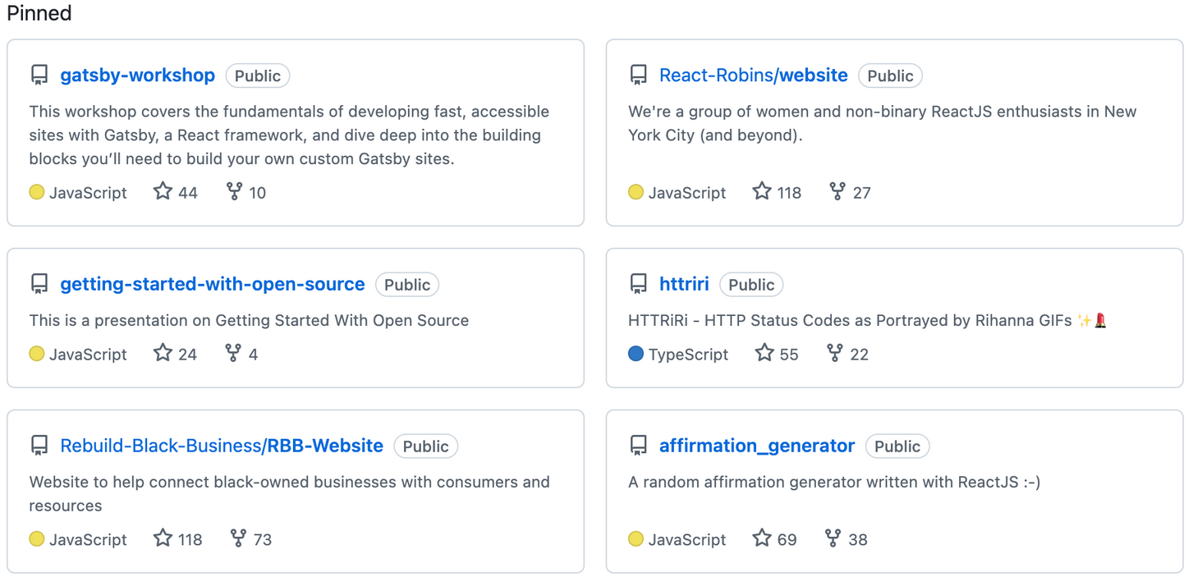
A Model Profile
-Showcases Skills and Projects
Pinned Repositories
For Business Students this could be:
Dashboards
Financial Analysis Tools
Collaborative Projects showing Real-World problem-solving skills.

Slide 7
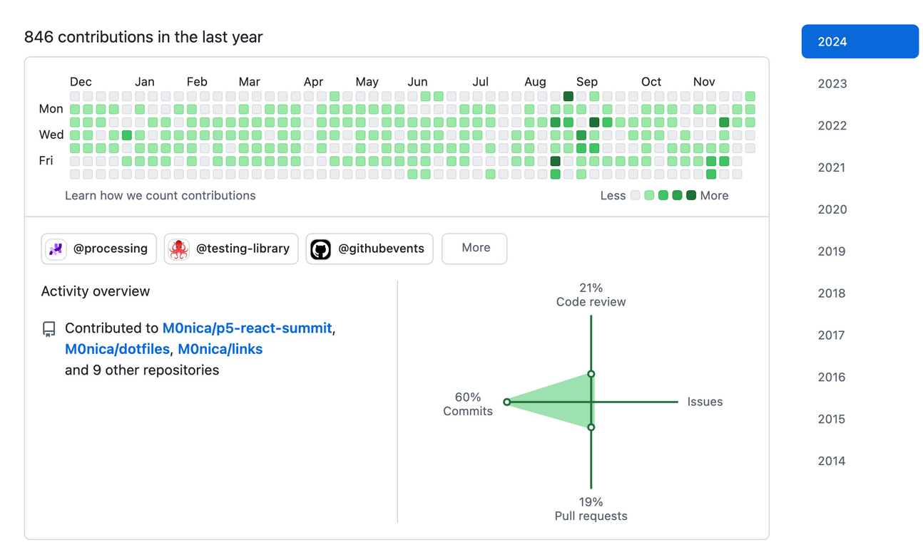
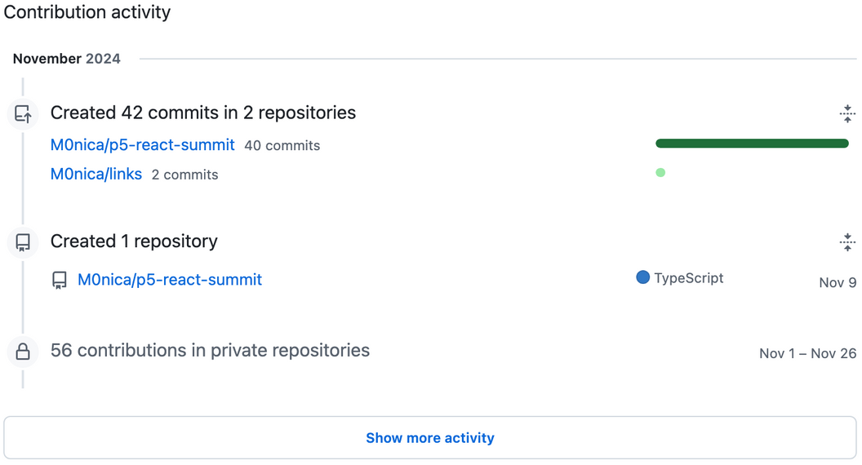
A Model Profile
-Consistant Activity
Contribution graph shows commitment
Consistent activity
Personal Projects
Collaborative Activity

Slide 8
What to avoid when making a Github profile:
1) No professional summary, professional profile photo, and other social media links
2) Ignoring visual appeal and making it hard to follow/understand
3) Inconsistent and irrelevant activity
4) Poor documentation and lack of description

Slide 9
GitHub
Vercel
Walk Through
Click here

Slide 10
GitHub
Python
Download Walk through

Slide 11
Python Intro
What is Python?
Purpose:
Python can be used on a server to create web applications.
Python can connect to database systems. It can also read and modify files.
Python can be used to handle big data and perform complex mathematics.
Python can be used for rapid prototyping, or for production-ready software development.
Programming is Problem Solving:
At its core, coding is about solving problems with a computer. In Python, you'll learn to communicate instructions that the computer can follow to perform tasks (e.g., math, text processing).
Basic Concepts:
Input: Getting information into your program (e.g., user entering a number).
Processing: Making decisions or performing calculations based on input.
Output: Showing the results or final answer to the user operation
Components:
Data Types
Variables
Functions
Control Flow
Module Flow
Classes & Objects
List Comprehension

Slide 12
Python Intro
Purpose
What is Python
Programming is Problem Solving:
At its core, coding is about solving problems with a computer. In Python, you'll learn to communicate instructions that the computer can follow to perform tasks (e.g., math, text processing).
Basic Concepts:
Input: Getting information into your program (e.g., user entering a number).
Processing: Making decisions or performing calculations based on input.
Output: Showing the results or final answer to the user operation
Python can be used on a server to create web applications.
Python can connect to database systems. It can also read and modify files.
Python can be used to handle big data and perform complex mathematics.
Python can be used for rapid prototyping, or for production-ready software development.
Components:
Data Types
Variables
Functions
Control Flow
Module Flow
Classes & Objects
List Comprehension

Slide 13
Python Intro
Components
What is Python
Programming is Problem Solving:
At its core, coding is about solving problems with a computer. In Python, you'll learn to communicate instructions that the computer can follow to perform tasks (e.g., math, text processing).
Basic Concepts:
Input: Getting information into your program (e.g., user entering a number).
Processing: Making decisions or performing calculations based on input.
Output: Showing the results or final answer to the user operation
Data Types
Variables
Functions
Control Flow
Module Flow
Classes & Objects
List Comprehension
Components:
Python can be used on a server to create web applications.
Python can connect to database systems. It can also read and modify files.
Python can be used to handle big data and perform complex mathematics.
Python can be used for rapid prototyping, or for production-ready software development.

Slide 14
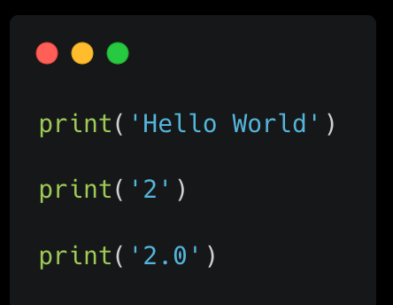
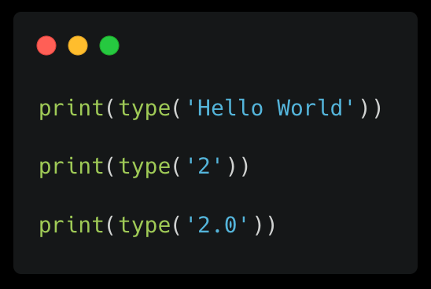
Python Basics
Print ()
.type()
Prints a statement to an output device (like a console) by using quotations
to determine type of variable varitable/action.type()

Slide 15
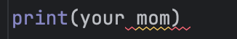
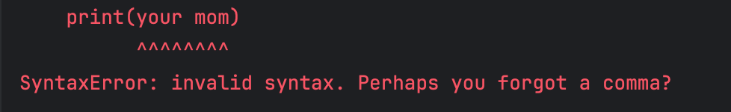
Python Basics
You must understand your errors!!
Input
Empathize
Output

Slide 16
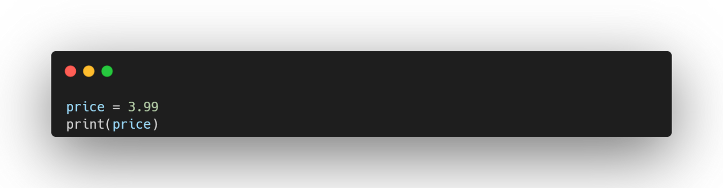
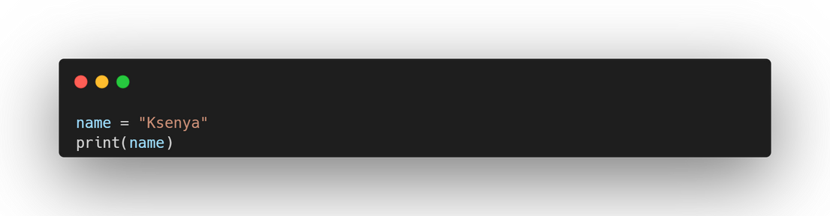
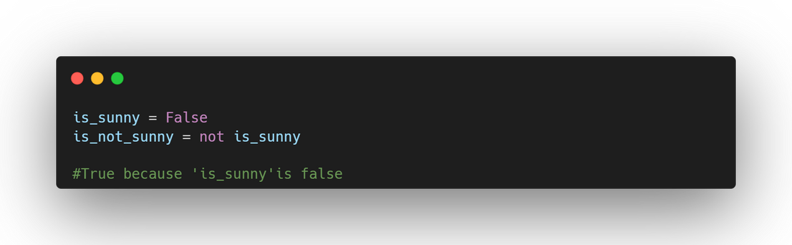
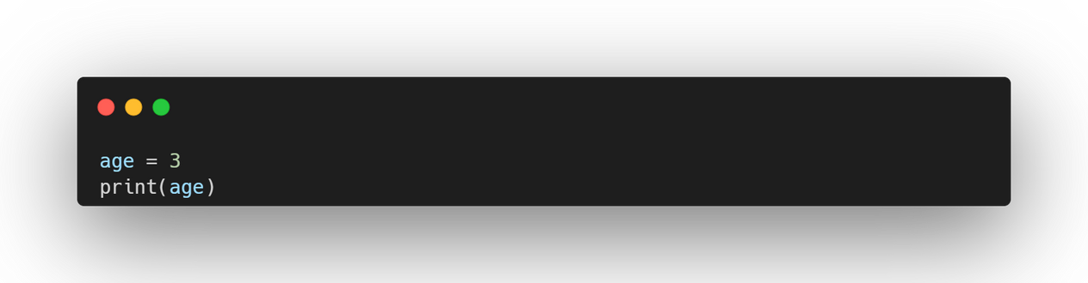
Python Basics
Variables
-Variables is something that is used to store values
-Compared to a cell in an excel sheet
-Main types of variables: string, integer, float, boolean
Float Variables:
An integer is a whole number (positive, negative, or zero).
Input:
String Variables:
A string is a sequence of characters enclosed in single or double quotes.
Ideate
Boolean Variables:
A boolean is a variable that can only be True or False.
Prototype
Input:
Input:
Integer Variables:
An integer is a whole number (positive, negative, or zero).
Input:

Slide 17
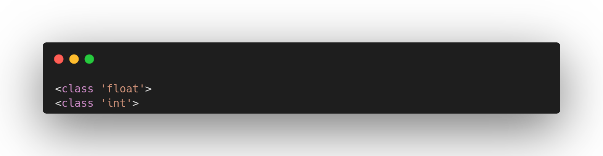
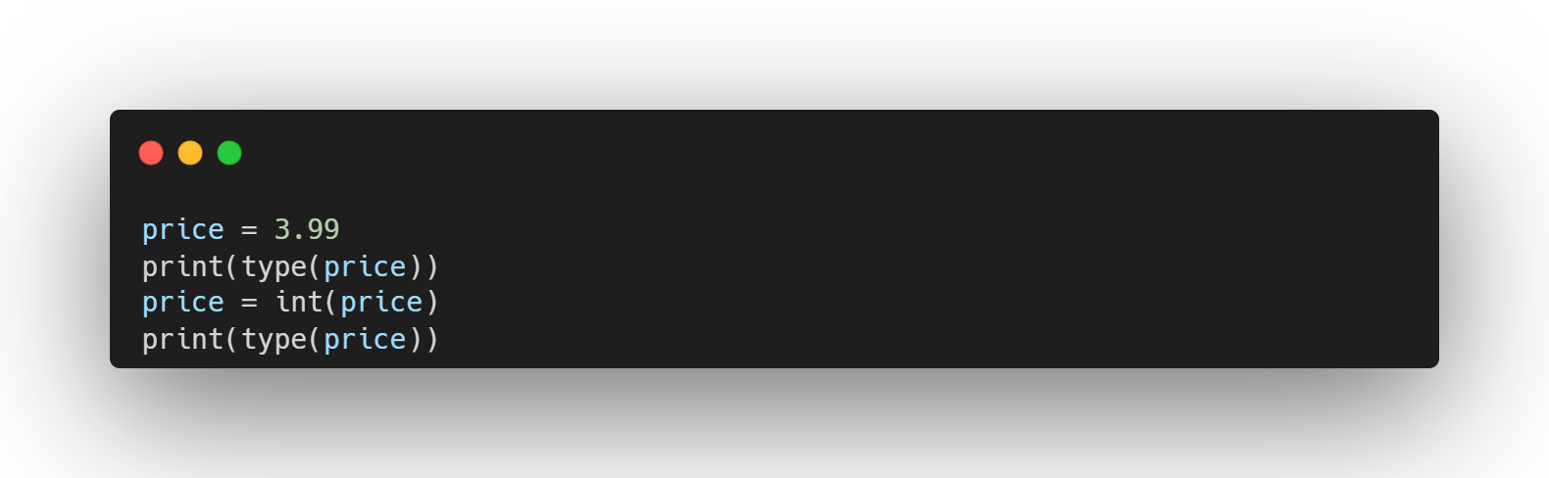
Python Basics
Change type variables
If you want to change the type of the variable:
string: str()
integer: int()
float: float()
Input
Output
Ideate

Slide 18
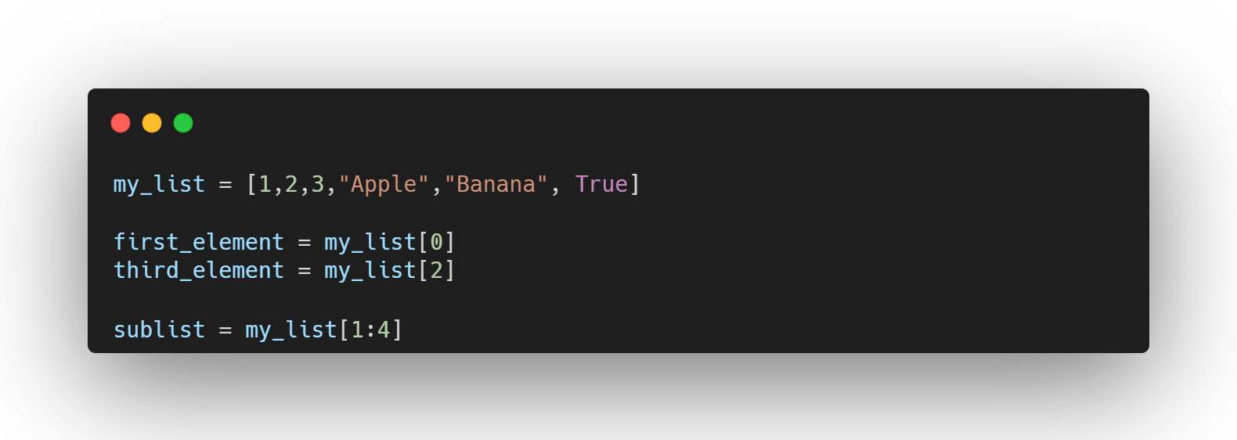
Python Basics
Lists
Lists in Python are ordered collections of items.
They are versatile and can store elements of different data types.
Accessing Elements:
You can access individual elements using their index, which starts from 0.
Slicing Lists:
You can extract a portion of a list using slicing.
Modifying Lists:
You can add, remove, or modify elements.
Iterating Over Lists:
You can iterate over each element using a for loop.
Test

Slide 19
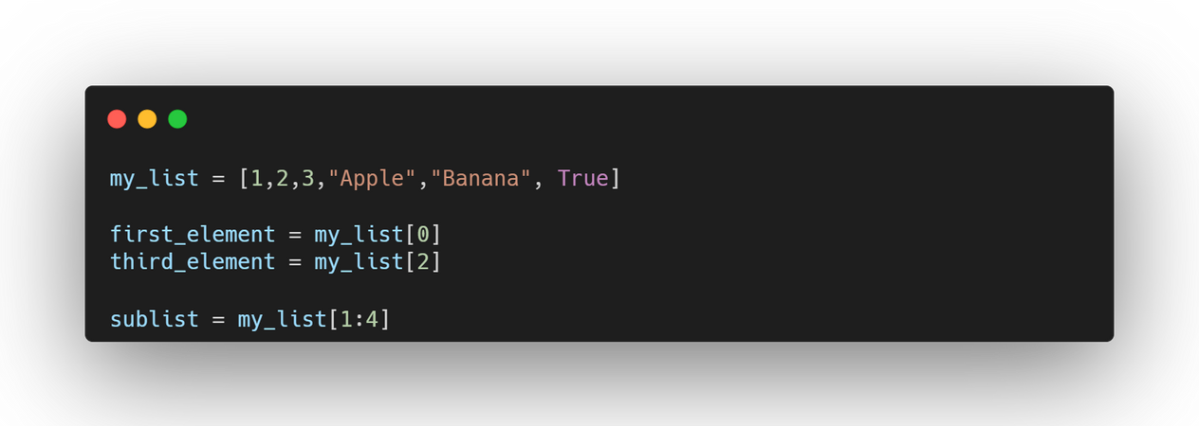
Python Basics
Lists
Lists in Python are ordered collections of items.
They are versatile and can store elements of different data types.
Common List Methods:
len(list): Returns the number of elements in the list.
list.sort(): Sorts the list in ascending order.
list.reverse(): Reverses the order of elements in the list.
list.clear(): Removes all elements from the list.
list.copy(): Creates a copy of the list.
Prototype
Test

Slide 20
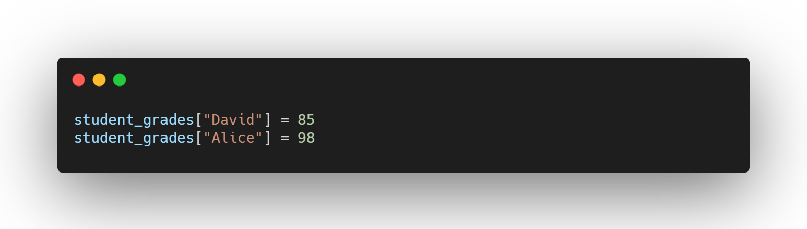
Python Basics
Dictionaries
Create Dictionary
Input
Dictionaries are a data structure in Python that store information in key-value pairs.
Think of them as a real-world dictionary where you look up a word (the key) to find its definition (the value).
Variable =
{}
Key :
Value :
Empathize
Adding and Modifying Entries:
You can add new key-value pairs or modify existing ones:

Slide 21
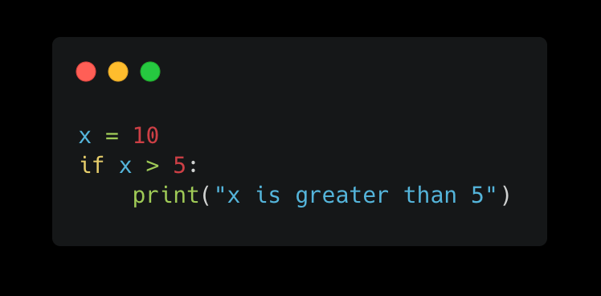
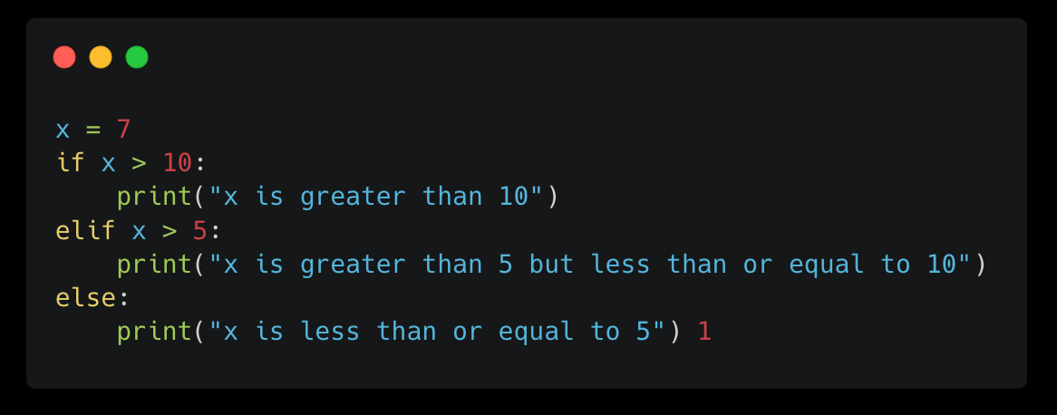
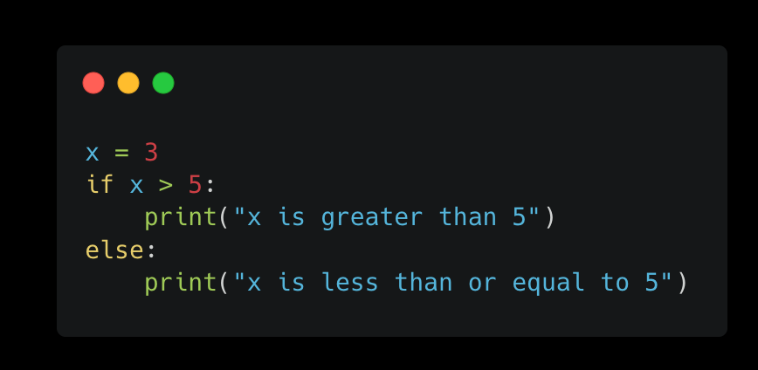
Python Basics
If statements
If statements are a fundamental control flow structure in programming languages, including Python.
They allow you to execute specific code blocks conditionally, based on whether a certain condition is true or false.

Slide 22
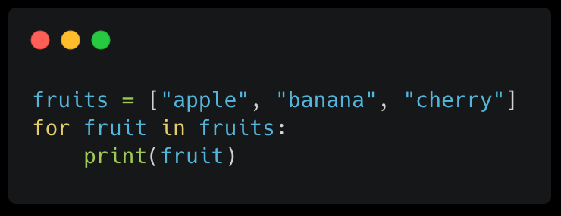
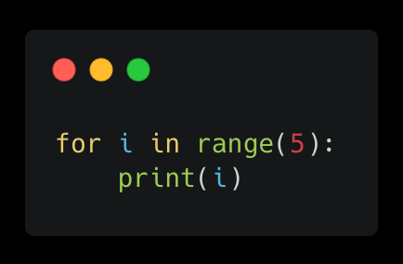
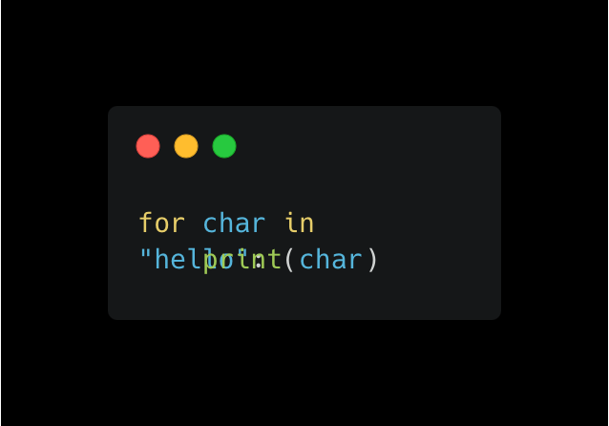
Python Basics
For Loops
For loops are used to iterate over a sequence of elements, such as a list, tuple, string, or range.
They allow you to execute a block of code repeatedly for each item in the sequence.
Explanation:
Initialization: The loop starts with the first item in the sequence.
Condition: The loop continues as long as there are more items in the sequence.
Iteration: The code block is executed for the current item.
Increment: The loop moves to the next item in the sequence.

Slide 23
Python Basics
For Loops
For loops are used to iterate over a sequence of elements, such as a list, tuple, string, or range.
They allow you to execute a block of code repeatedly for each item in the sequence.
Explanation:
Initialization: The loop starts with the first item in the sequence.
Condition: The loop continues as long as there are more items in the sequence.
Iteration: The code block is executed for the current item.
Increment: The loop moves to the next item in the sequence.

Slide 24
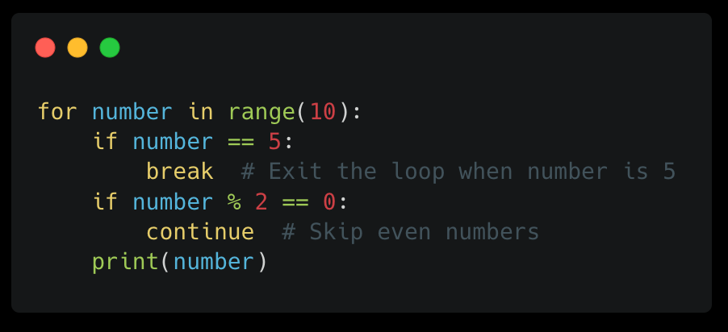
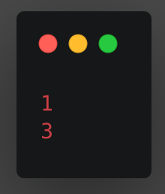
Python Basics
For Loops
Key Points:
Indentation: The code within the loop must be indented.
Flexibility: For loops can be used with various data structures.
Efficiency: They provide a concise way to process sequences.
Control Flow: You can use break to exit the loop early or continue to skip to the next iteration.

Slide 25
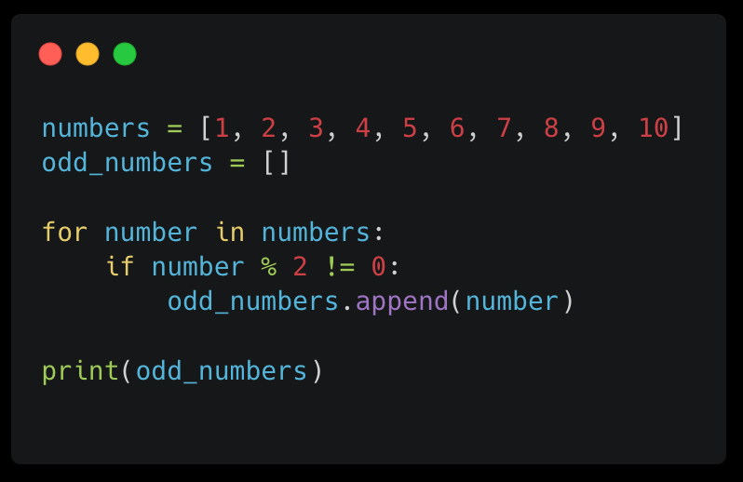
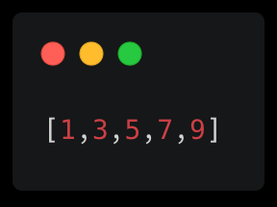
Python Basics
1. Initializing the Lists:
numbers = [1, 2...
This creates a list named numbers containing integers from 1 to 10.
odd_numbers = []:
This creates an empty list named odd_numbers to store the odd numbers.
2. Iterating Over the Numbers:
for number in numbers:
This line starts a for loop. It iterates over each number in the numbers list, assigning the current number to the variable number in each iteration.
3. Checking for Odd Numbers:
if number % 2 != 0:
This line checks if the current number is odd. The modulo operator (%) calculates the remainder when number is divided by 2. If the remainder is not 0, the number is odd.
4. Appending Odd Numbers to the List:
odd_numbers.append(number):
If the number is odd, this line adds it to the odd_numbers list using the append() method.
5. Printing the Odd Numbers:
print(odd_numbers):
This line prints the final odd_numbers list, which now contains only the odd numbers from the original list.
Filtering a List:

Slide 26
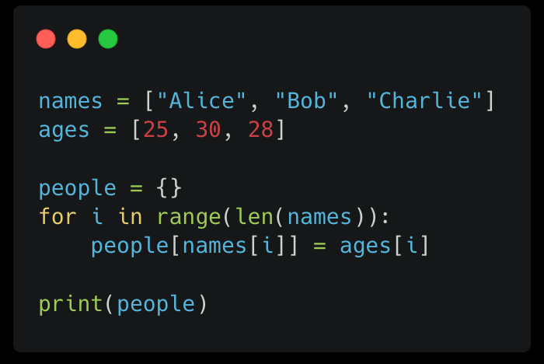
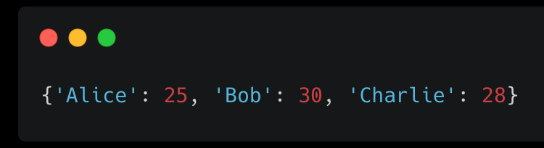
Python Basics
Filtering a List:
1. Initializing Lists:
names = ["Alice", "Bob", "Charlie"]:
This creates a list named names containing three names.
ages = [25, 30, 28]:
This creates a list named ages containing three corresponding ages.
2. Creating an Empty Dictionary:
people = {}:
This creates an empty dictionary named people. A dictionary is a data structure that stores key-value pairs. In this case, the names will be the keys, and the ages will be the values.
3. Iterating Over the Lists:
for i in range(len(names))::
This line starts a for loop. The range(len(names)) part generates a sequence of numbers from 0 to 2 (the length of the names list minus 1). The loop iterates over each number in this sequence, assigning it to the variable i in each iteration.
4. Populating the Dictionary:
people[names[i]] = ages[i]:
This line adds a new key-value pair to the people dictionary in each iteration.
names[i]:
This part accesses the name at the index i in the names list.
ages[i]:
This part accesses the age at the index i in the ages list.
The key-value pair is added to the dictionary, where the name is the key and the age is the value.

Slide 27
Python Basics
Python Libraries
The Point of Libraries: A Code-Level Perspective
In programming, libraries are collections of pre-written code that you can reuse in your own projects. Think of them as toolboxes filled with specialized tools. By using libraries, you can:
Reusability: Libraries provide ready-made functions and classes for common tasks, eliminating the need to write code from scratch.
Efficiency: Library functions are often highly optimized, leading to faster and more efficient code.
Community-Driven: Many libraries are developed and maintained by large communities of experienced programmers.
Quality Assurance: These libraries are often thoroughly tested and debugged, reducing the risk of errors in your own code.
Complex Functionality: You can tackle complex problems by using libraries that provide specialized solutions.
Consistent Code: Libraries often enforce coding standards and best practices.

Slide 28
Python Basics
Python Libraries
Matplotlib is a powerful and versatile Python library designed to create a wide range of static, animated, and interactive visualizations. It provides a flexible interface for customizing plots, making it a go-to tool for data scientists, engineers, and researchers.
Diverse Plot Types:
Line Plots: Visualize trends and patterns over time or across categories.
Scatter Plots: Explore relationships between two numerical variables.
Bar Charts: Compare categorical data using bars.
Histograms: Analyze the distribution of numerical data.
Pie Charts: Show the composition of categorical data.
Box Plots: Visualize the distribution of data, including outliers.
Heatmaps: Represent data in a matrix format, with color-coded values.
3D Plots: Create three-dimensional visualizations for complex data.
Key Features of NumPy:
Customization and Style:
Integration with Other Libraries:

Slide 29
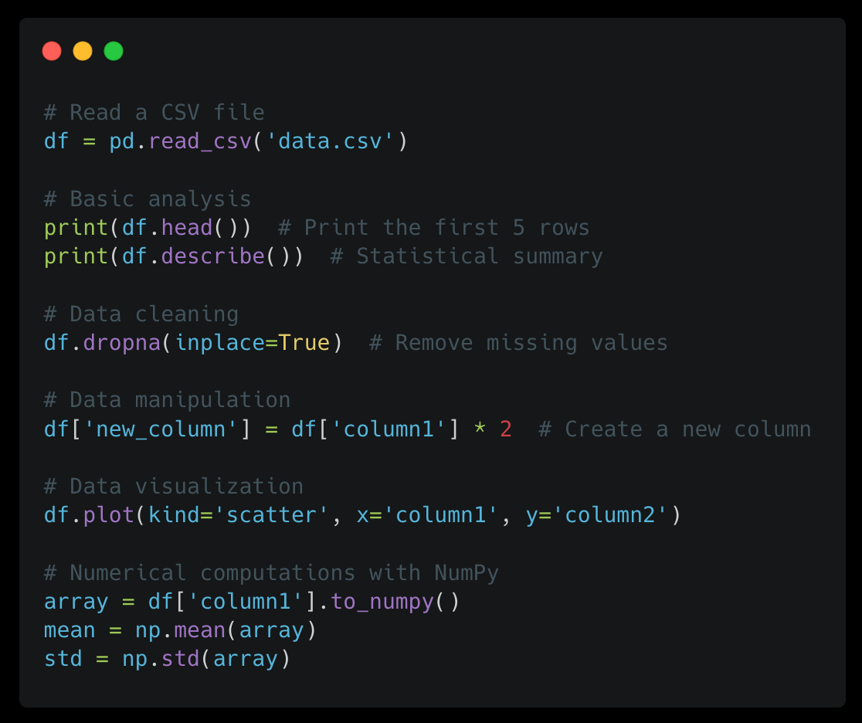
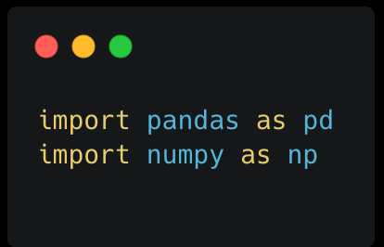

Slide 30
Python Basics
Python Libraries
Pandas: Data Analysis and Manipulation
Pandas builds on top of NumPy, providing high-performance, easy-to-use data structures and data analysis tools.
Key Features of Pandas:
Series and DataFrames: Two primary data structures
Series: One-dimensional array with labels.
DataFrame: Two-dimensional labeled data structure, similar to a spreadsheet.
Data Import/Export: Read data from various file formats (CSV, Excel, JSON, etc.) and write data to different formats.
Data Cleaning and Preparation: Handle missing values, outliers, and inconsistencies.
Data Analysis: Perform statistical calculations, filtering, sorting, and grouping operations.
Data Visualization: Create informative visualizations using built-in plotting functions or external libraries like Matplotlib and Seaborn.

Slide 31
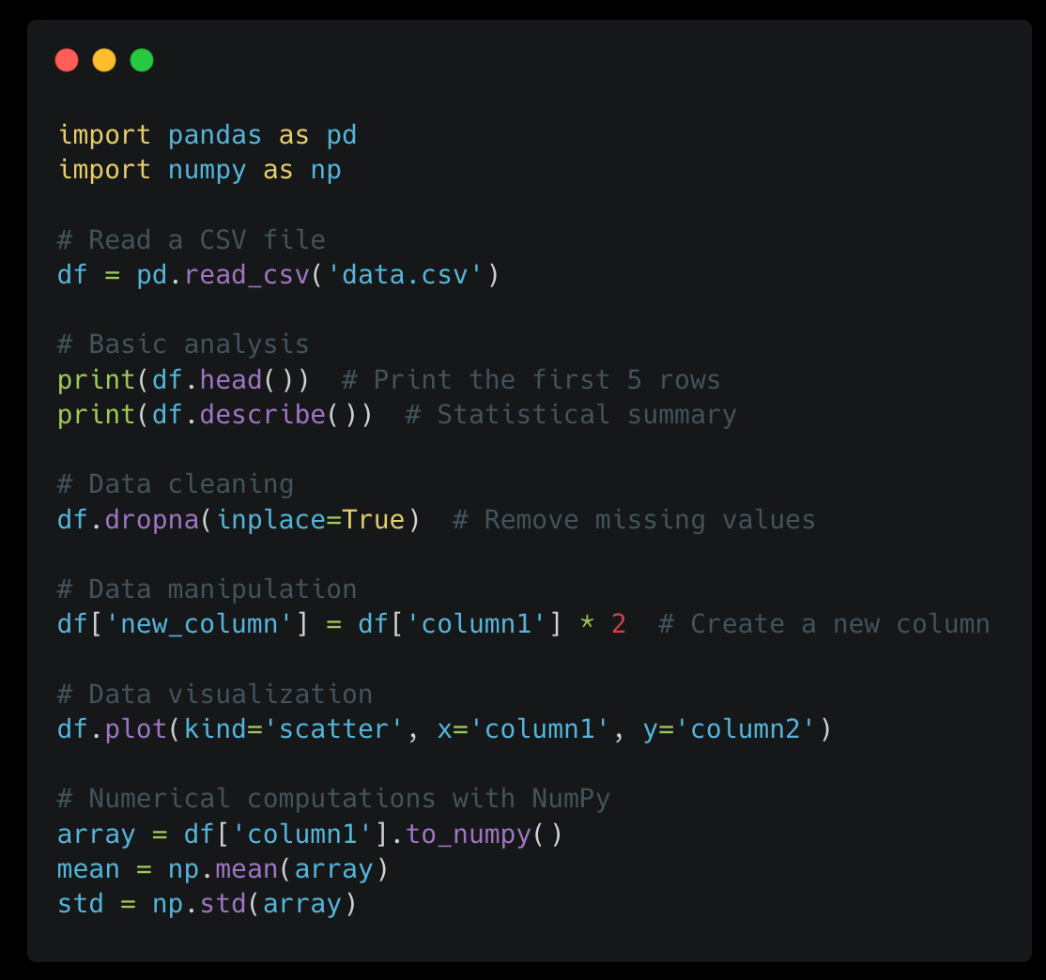
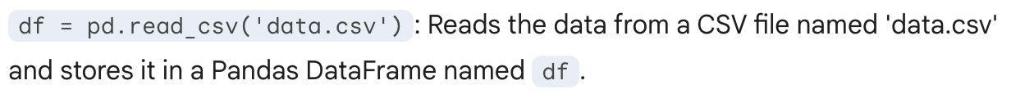
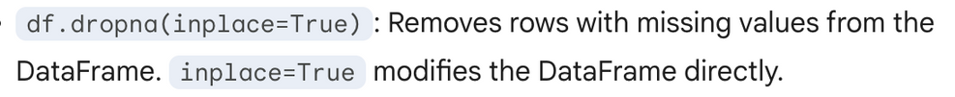
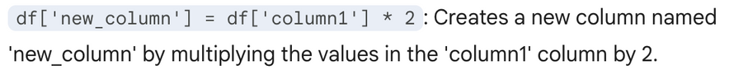
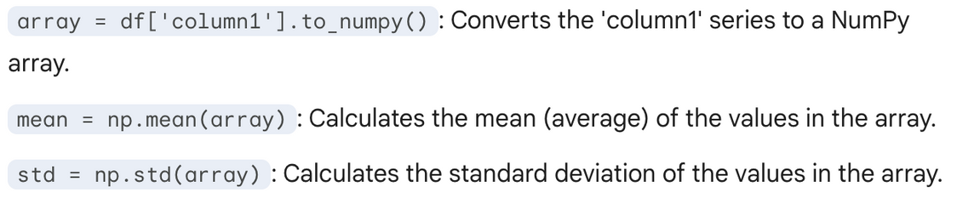
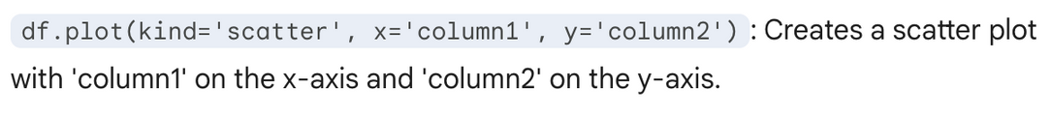

Slide 32
Python Basics
String Methods
List Methods
Empathize
Python Libraries
Questions?

Slide 33
Business Case
Tracking Portfolio Performance
Investors often struggle to keep up with daily stock price fluctuations and portfolio valuations.
The challenge is to create a simple system that tracks stock prices and provides a quick snapshot of portfolio performance, focusing on:
Accurately analyze stock information (name, quantity, purchase price, and current price).
Providing insights into individual stock gains or losses.

Slide 34

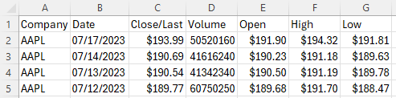
Looking at the CSV File
First download the dataset
Take a look at the dataset

Slide 35

Break down the business problem
Let’s break down the case objectives into programming objectives:
Accurately analyze stock information
Providing insights into individual stock gains or losses.

Slide 36


Break down the business problem
Accurately analyze stock information
Loading the data
Process the data
Providing insights into individual stock gains or losses.
Printing the monthly percentage change
Data visualization

Slide 37
Break down the business problem
Accurately analyze stock information
Loading the data
Use pandas to the load the csv file
Parse the numerical values (remove dollar sign, convert to float)
Convert date strings into datetime format
Sort by company, then by date
Process the data
Filter The Data for only 2022
Calculate monthly percentage change
Calculate the value of an 1000 dollar investment for each day
Providing insights into individual stock gains or losses.
Printing the monthly percentage change
Data visualization
Set up axis (x,y)
Set up datasource
Set up legend
Show the visualization

Slide 38
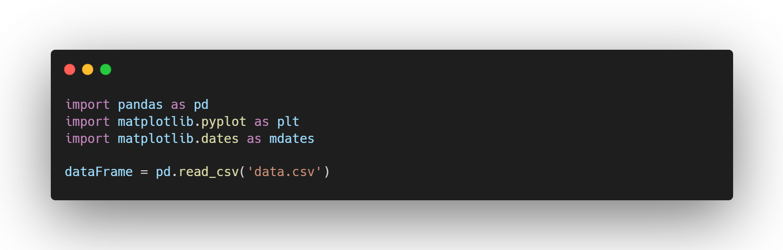
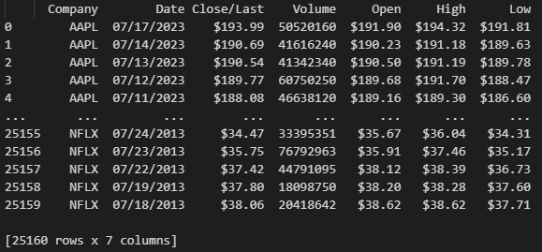
Break down the business problem
Accurately analyze stock information
Loading the data
Use pandas to the load the csv file
Parse the numerical values (remove dollar sign, convert to float)
Convert date strings into datetime format
Sort by company, then by date
Process the data
Filter The Data for only 2022
Calculate monthly percentage change
Calculate the value of an 1000 dollar investment for each day
Providing insights into individual stock gains or losses.
Printing the monthly percentage change
Data visualization
Set up axis (x,y)
Set up datasource
Set up legend
Show the visualization
Output of Dataframe:

Slide 39
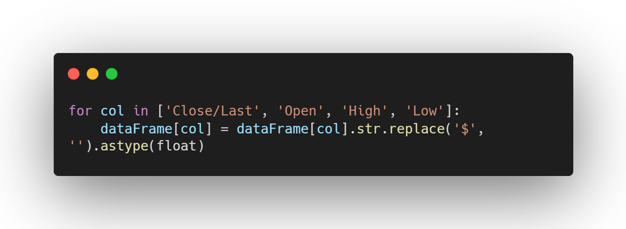
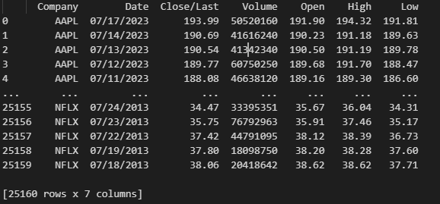
Break down the business problem
Accurately analyze stock information
Loading the data
Use pandas to the load the csv file
Parse the numerical values (remove dollar sign, convert to float)
Convert date strings into datetime format
Sort by company, then by date
Process the data
Filter The Data for only 2022
Calculate monthly percentage change
Calculate the value of an 1000 dollar investment for each day
Providing insights into individual stock gains or losses.
Printing the monthly percentage change
Data visualization
Set up axis (x,y)
Set up datasource
Set up legend
Show the visualization
Before:
After:

Slide 40
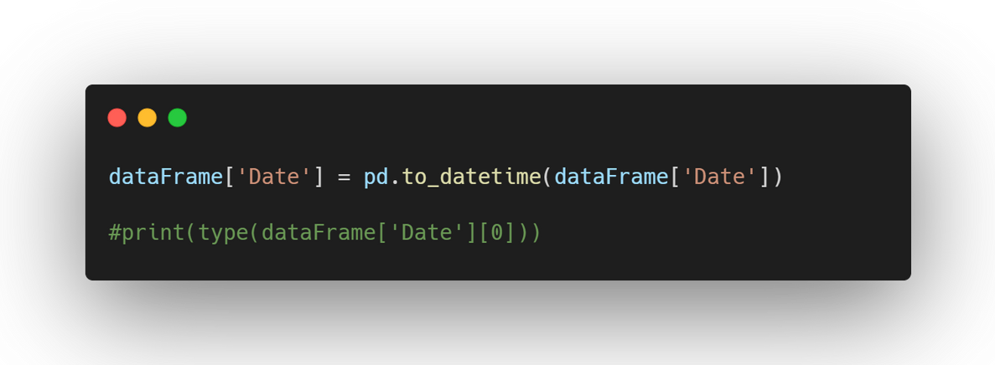
Break down the business problem
Accurately analyze stock information
Loading the data
Use pandas to the load the csv file
Parse the numerical values (remove dollar sign, convert to float)
Convert date strings into datetime format
Sort by company, then by date
Process the data
Filter The Data for only 2022
Calculate monthly percentage change
Calculate the value of an 1000 dollar investment for each day
Providing insights into individual stock gains or losses.
Printing the monthly percentage change
Data visualization
Set up axis (x,y)
Set up datasource
Set up legend
Show the visualization
Output:

Slide 41
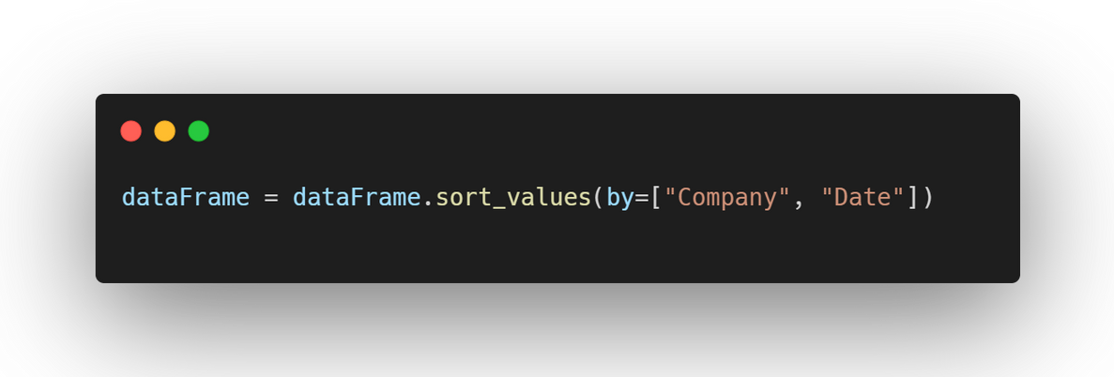
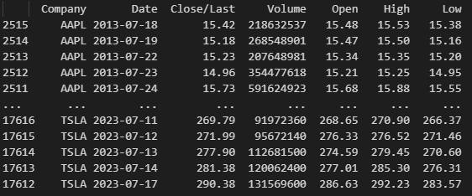
Break down the business problem
Accurately analyze stock information
Loading the data
Use pandas to the load the csv file
Parse the numerical values (remove dollar sign, convert to float)
Convert date strings into datetime format
Sort by company, then by date
Process the data
Filter The Data for only 2022
Calculate monthly percentage change
Calculate the value of an 1000 dollar investment for each day
Providing insights into individual stock gains or losses.
Printing the monthly percentage change
Data visualization
Set up axis (x,y)
Set up datasource
Set up legend
Show the visualization
Before:
After:

Slide 42
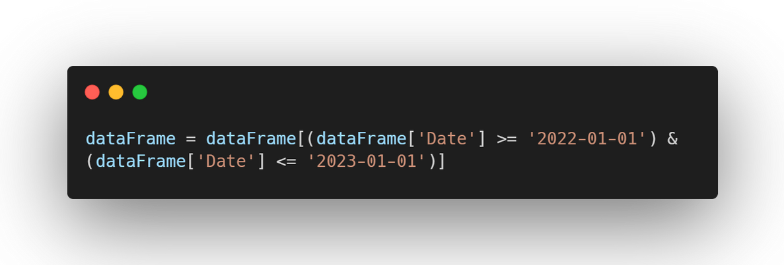
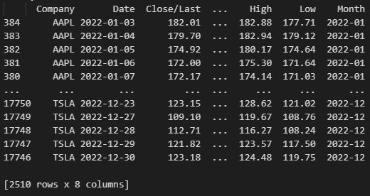
Break down the business problem
Accurately analyze stock information
Loading the data
Use pandas to the load the csv file
Parse the numerical values (remove dollar sign, convert to float)
Convert date strings into datetime format
Sort by company, then by date
Process the data
Filter The Data for only 2022
Calculate monthly percentage change
Calculate the value of an 1000 dollar investment for each day
Providing insights into individual stock gains or losses.
Printing the monthly percentage change
Data visualization
Set up axis (x,y)
Set up datasource
Set up legend
Show the visualization
Before:
After:

Slide 43
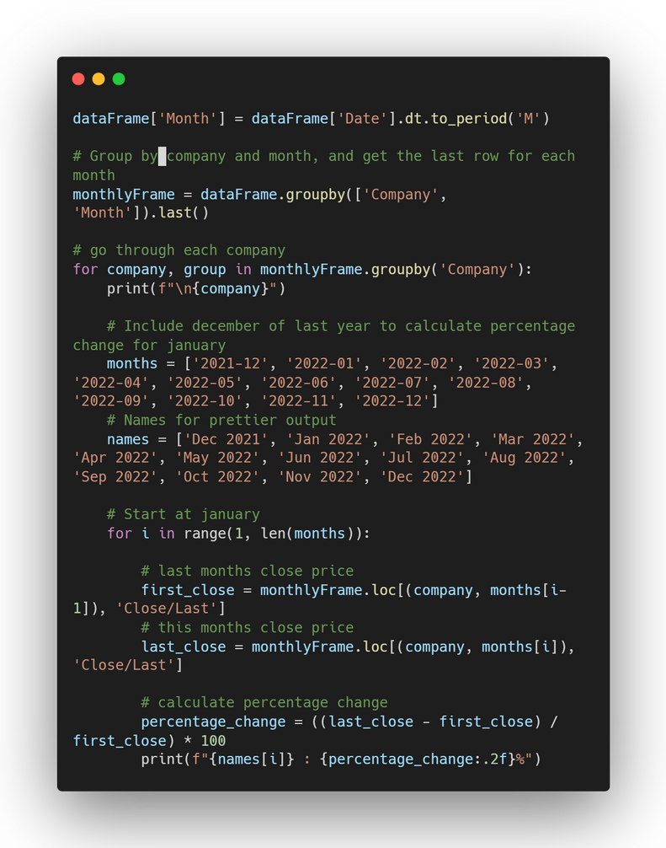
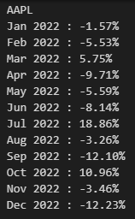
Break down the business problem
Accurately analyze stock information
Loading the data
Use pandas to the load the csv file
Parse the numerical values (remove dollar sign, convert to float)
Convert date strings into datetime format
Sort by company, then by date
Process the data
Filter The Data for only 2022
Calculate monthly percentage change
Calculate the value of an 1000 dollar investment for each day
Providing insights into individual stock gains or losses.
Printing the monthly percentage change
Data visualization
Set up axis (x,y)
Set up datasource
Set up legend
Show the visualization

Slide 44


Break down the business problem
Accurately analyze stock information
Loading the data
Use pandas to the load the csv file
Parse the numerical values (remove dollar sign, convert to float)
Convert date strings into datetime format
Sort by company, then by date
Process the data
Filter The Data for only 2022
Calculate monthly percentage change
Calculate the value of an 1000 dollar investment for each day
Providing insights into individual stock gains or losses.
Printing the monthly percentage change
Data visualization
Set up axis (x,y)
Set up datasource
Set up legend
Show the visualization
Output:

Slide 45

Break down the business problem
Accurately analyze stock information
Loading the data
Use pandas to the load the csv file
Parse the numerical values (remove dollar sign, convert to float)
Convert date strings into datetime format
Sort by company, then by date
Process the data
Filter The Data for only 2022
Calculate monthly percentage change
Calculate the value of an 1000 dollar investment for each day
Providing insights into individual stock gains or losses.
Printing the monthly percentage change
Data visualization
Set up axis (x,y)
Set up datasource
Set up legend
Show the visualization
Output:

Slide 46

Break down the business problem
Accurately analyze stock information
Loading the data
Use pandas to the load the csv file
Parse the numerical values (remove dollar sign, convert to float)
Convert date strings into datetime format
Sort by company, then by date
Process the data
Filter The Data for only 2022
Calculate monthly percentage change
Calculate the value of an 1000 dollar investment for each day
Providing insights into individual stock gains or losses.
Printing the monthly percentage change
Data visualization
Set up datasource
Set up axis (x,y)
Set up legend
Show the visualization

Slide 47

Break down the business problem
Accurately analyze stock information
Loading the data
Use pandas to the load the csv file
Parse the numerical values (remove dollar sign, convert to float)
Convert date strings into datetime format
Sort by company, then by date
Process the data
Filter The Data for only 2022
Calculate monthly percentage change
Calculate the value of an 1000 dollar investment for each day
Providing insights into individual stock gains or losses.
Printing the monthly percentage change
Data visualization
Set up datasource
Set up axis (x,y)
Set up legend
Show the visualization

Slide 48
Things you can implement within the code
Easy
Change the filtering dates (On line 69)
Plot one company instead of all 10 (On line 98)
On the console, print out all the months based on months (on line 43) or names list (on line 45)
Difficult
Create a visualization with plotly instead of matplotlib
Interactive data filtering (based on user input)

Slide 49


If you want to learn python + download the program
Link to Github To download the Program
Good Resource for Learning Python
My email: Ikim63@uwo.ca

Slide 50
Video List

Slide 51

Functions in Python

